Slide 1
MATH IS FUN!
eTwinning project
We present some ideas of geometry.

Slide 2
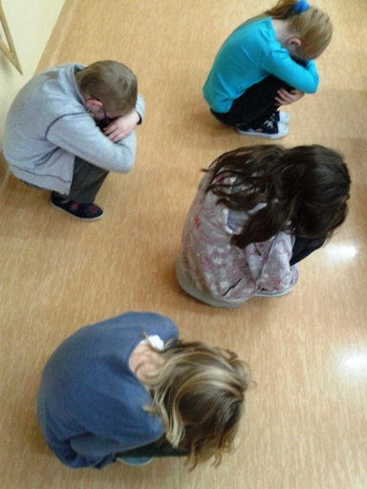
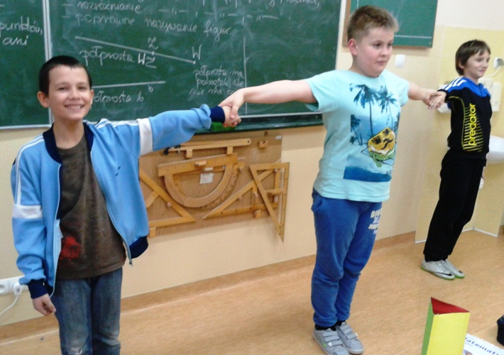
Class 4C
Children used their bodies to build
basic geometric figures. You can build
the same way the other figures, have fun.
points
line segment

Slide 3
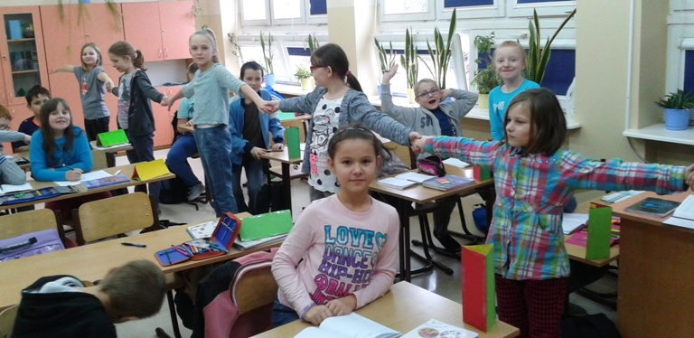
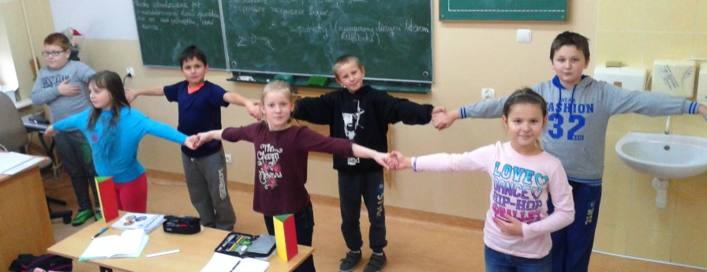
line
two rays

Slide 4
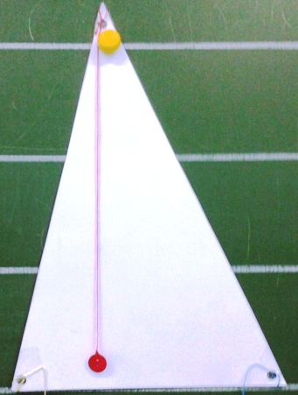
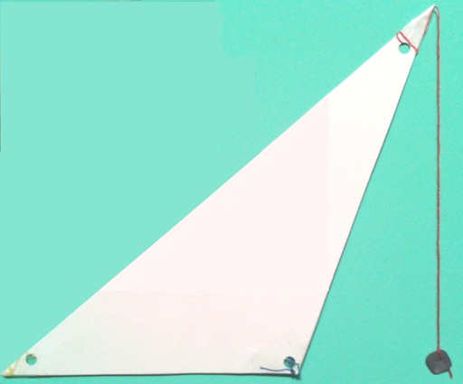
Class 5C
Introducing the concept of the height of the triangle
Pupils watch various models of the triangles.
The height of the triangle is shown by string.
Obtuse triangle
Right triangle
Acute triangle

Slide 5
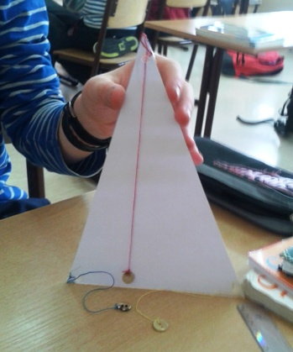
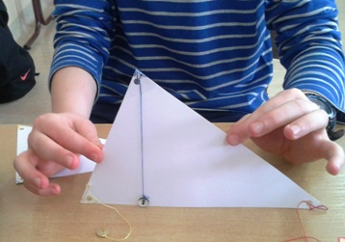
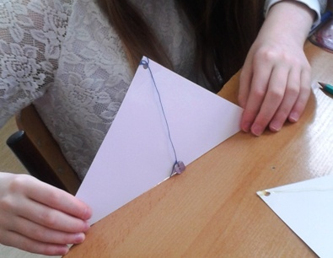

Slide 6
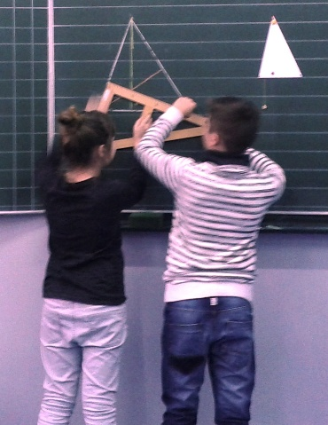
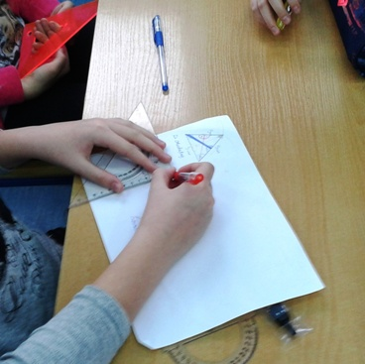
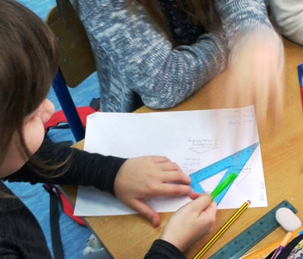
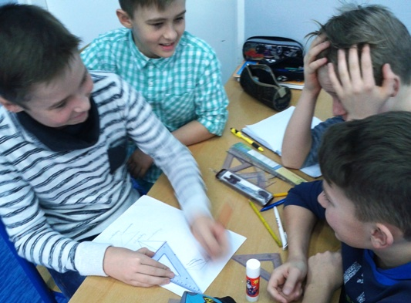
Children draw the various heights of triangles

Slide 7
Greetings from Nowiny

